Slide 1


Slide 2
The Agenda
The Group
The Project
The Expanded Use cases
The UI Prototypes
The Sequence Diagram
The Design Class Diagram
The Code Collaboration

Slide 3
The Group
Group Number 3
Team X-Mod
Team Mates
Parth Desai
Padma Channal
Aman Nagar
Ketaki Chinchorkar
Vyankatesh Kulkarni
Jidnyasa Dhavale
Tejaswi Singh
Nirmik Kale

Slide 4
The Project
Demo

Slide 5
The Expanded UCs
UC: Create new category
Precondition: The admin should be logged in MavsSnapUp system.
Actor : Admin | System : MavsSnapUp
 | 0. System displays the Admin homepage with create new category section.
1. TUCBW the Admin user enters new category name in the category name text box and clicks create button. | 2. The system displays the success message and creates new category.
3. TUCEW The Admin views success message.
Post condition: The new category is created and can be used by student user.

Slide 6
The Expanded UCs
UC: Select category
Precondition : The user should be logged in to the MavsSnapUp system
Actor : UTA Student Seller User | System : MavsSnapUp
 | 0. System displays Home Page
1. TUCBW the user clicks on the “+” button to upload new items. | 2. System displays the form to be filled by the user regarding the details of the new item.
3. After adding all the details, user selects a category from the drop down available which include newly created categories too. User clicks create button. | 4. System associating the selected category to the item.
5. TUCEW user can see the uploaded item associated with the category.
Postcondition: The new category is selected and is associated with the item.

Slide 7
The Expanded UCs
UC: View Item
Precondition: The student user should be logged in to the MavsSnapUp system
Actor: UTA Student as a buyer User | System : MavsSnapUp
 | 0. System Displays Home Page with the list of available items to buy.
1. TUCBW the student user clicks on the item to view item details. | 2. System displays the details of the item in a new screen.
5. TUCEW the student user viewing the item details with an option to make an offer.
Post condition: The student user can see the details of the item.

Slide 8
The Expanded UCs
UC: Mark as sold
Precondition: The student user should be logged in to the MavsSnapUp system
Actor: UTA Student Seller User | System: MavsSnapUp
 | 0. System displays the home screen of the application.
1. TUCBW The Student user as seller clicks Uploaded Items button. | 2. System displays the list of the items in a new screen.
3. The Student user as a seller clicks on an item to view its details. | 4. System displays the details of the item in a new screen.
5. The Student user as a seller click on Mark as Sold button on the item details screen. | 6. System displaying the success message.
7. TUCEW seller can see the success message and the item is delisted.
Postcondition: The item marked as sold is delisted from the application.

Slide 9
The Expanded UCs
UC: Make an Offer
Precondition: The student user should be logged in to the MavsSnapUp system
Actor: UTA Student as a Buyer User | System: MavsSnapUp
 | 0. System Displays Home Page with the list of available items to buy.
1. TUCBW the student user clicks on the item to view item details. | 2. System displays the details of the item in a new screen.
3. The student user viewing the item details clicks an option to make an offer. | 4. Student will get details of seller.
5. TUCEW Offer gets created.
Postcondition: The student user can see the created offer.

Slide 10
The UI Prototype
https://o7ogcm.axshare.com/

Slide 11
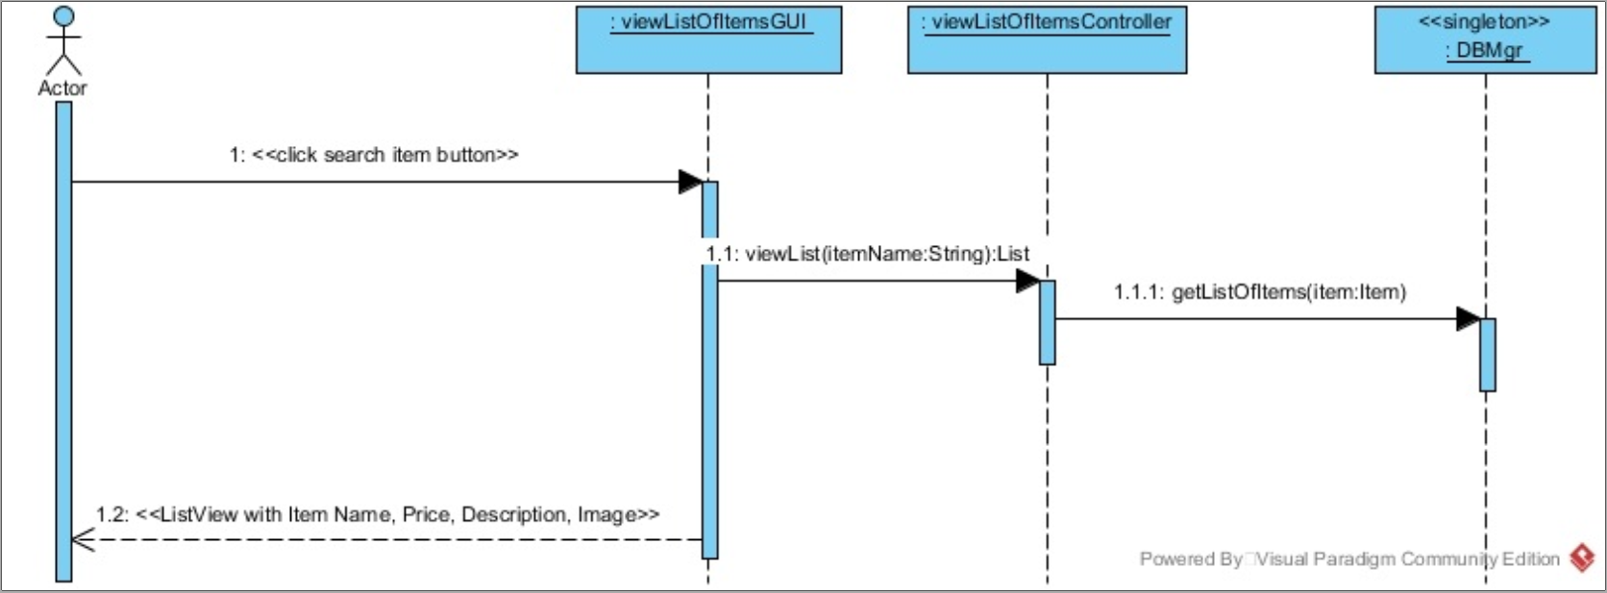
The Sequence Diagrams
View List Of Items

Slide 12
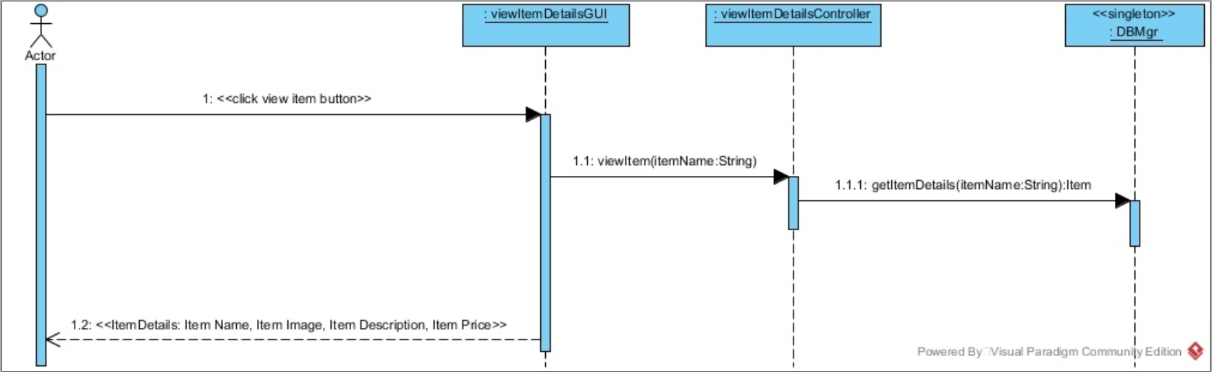
The Sequence Diagrams
View Item Details

Slide 13
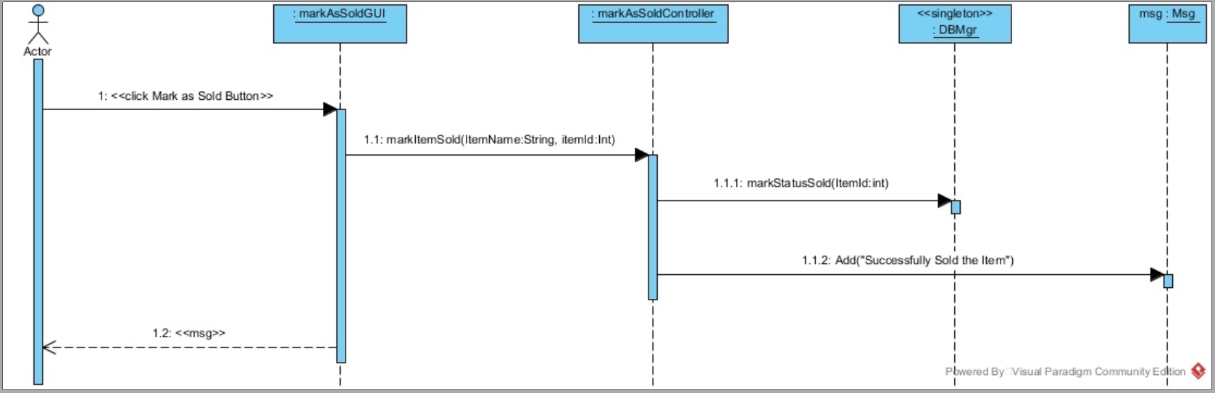
The Sequence Diagrams
Mark As Sold

Slide 14
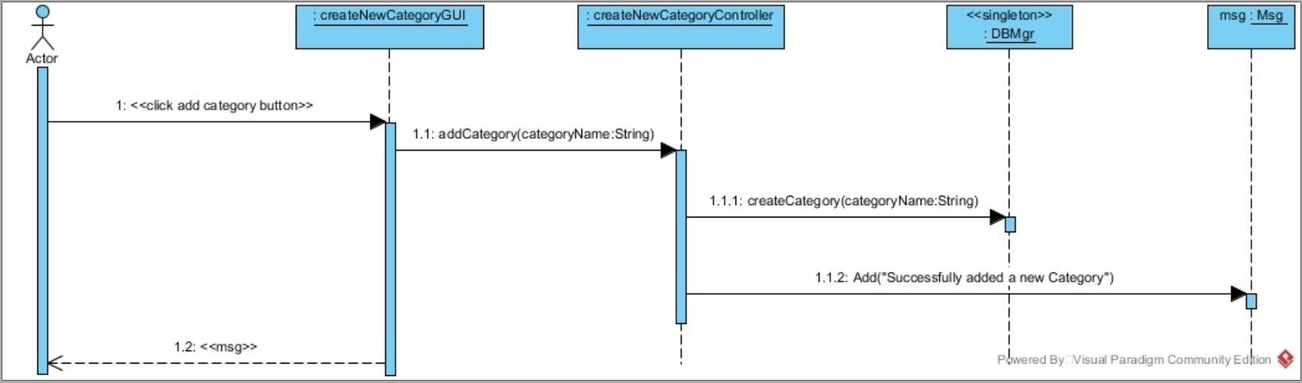
The Sequence Diagrams
Create New Category

Slide 15
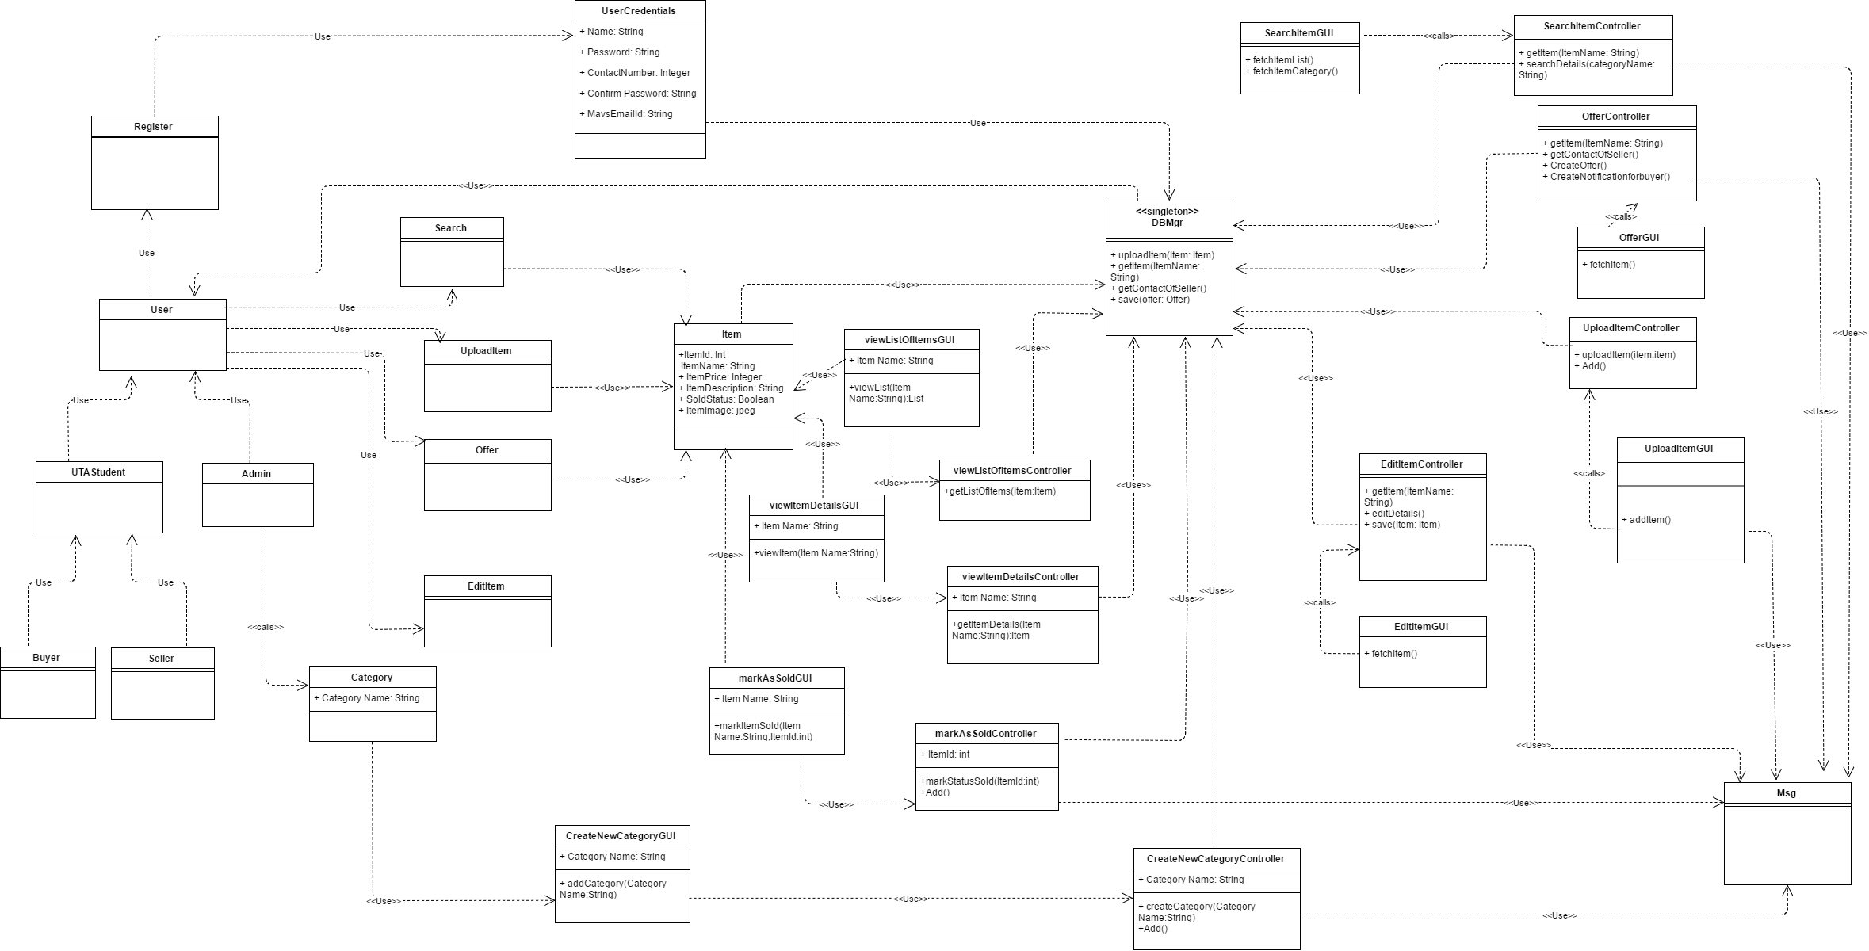
The Design Class Diagram

Slide 16
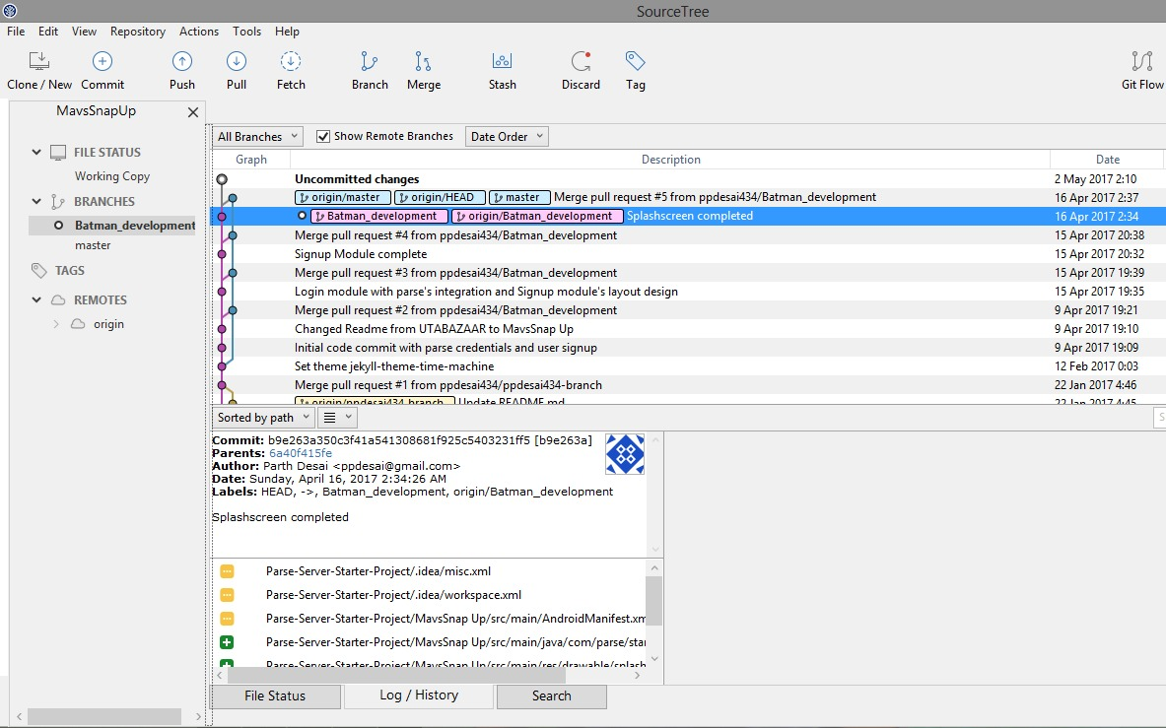
The Code Collaboration

Slide 17


